Slide 1
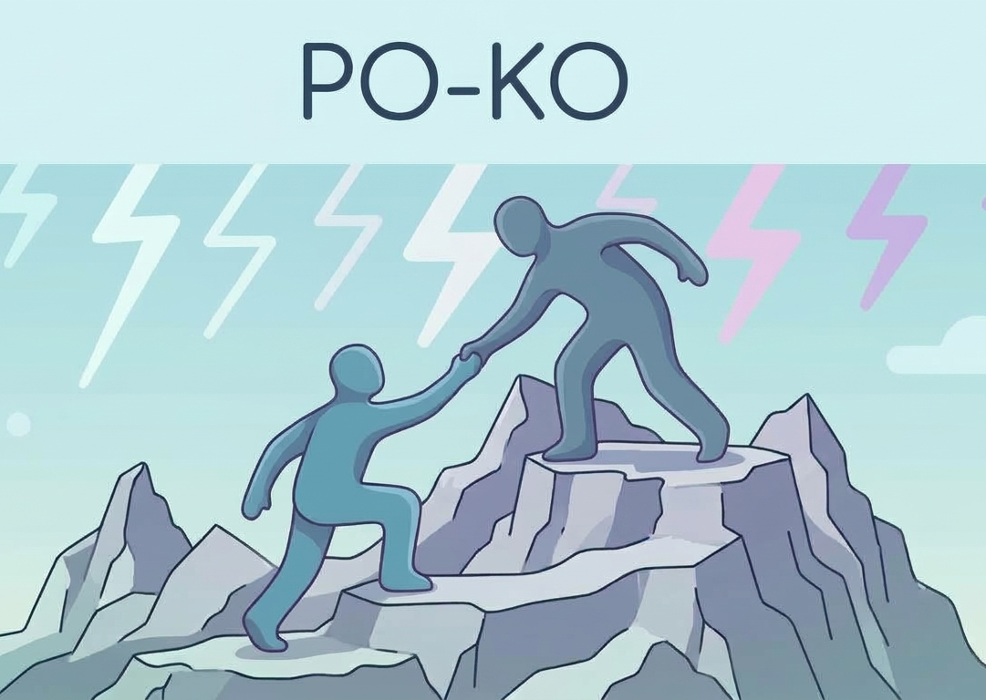
Po-Ko Developer Capacity Guardian
Turning developer recovery signals into safer software decisions
The tech industry expects developers to operate like machines, but we built a framework that treats them like humans.

Slide 2
From Invisible Fatigue to Safer Decisions
Wearable Signals
HRV • Sleep • Stress
↓
Po-Ko Score
Explainable recovery state
↓
IBM Bob
Context-aware advice
↓
Git Guardian
Support-aware commit traceability

